Slide 1
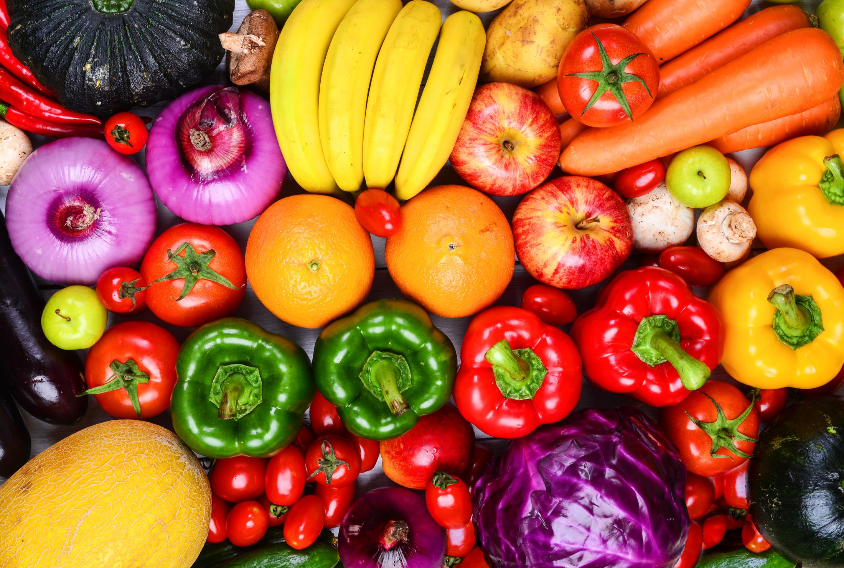
Food and Beverage Market Analysis
Designer：Hajira Kousar

Slide 2
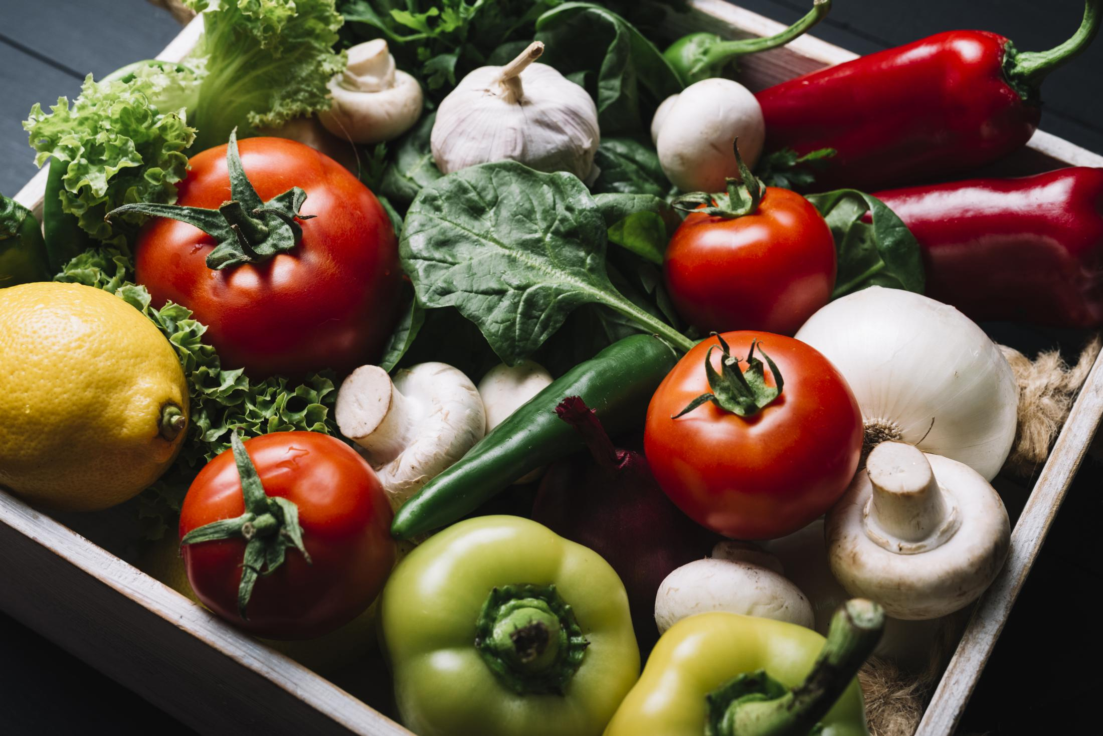
CONTENT
Overview
> It is a substantial part of F&B activities of the hotel and catering industry.
> F&B operations are characterized by their diversity.
>Broadly manager’s functions are:-
1. Planning process, setting objectives,making decisions,formulating policies.
2. Analyzing tasks and assigning individuals or groups.
3. Involved in staff movtivation to move the organization.
Goals
> Market to satisfy guest’s expecctations.
> The purcchasing , receiving,storing , issusing and preparation of food and beverages for final provision.
> Training , directing , motivating and monitoring.
>Feedback from guest, comment, complaints and compliments for improve overall standards.

Slide 3
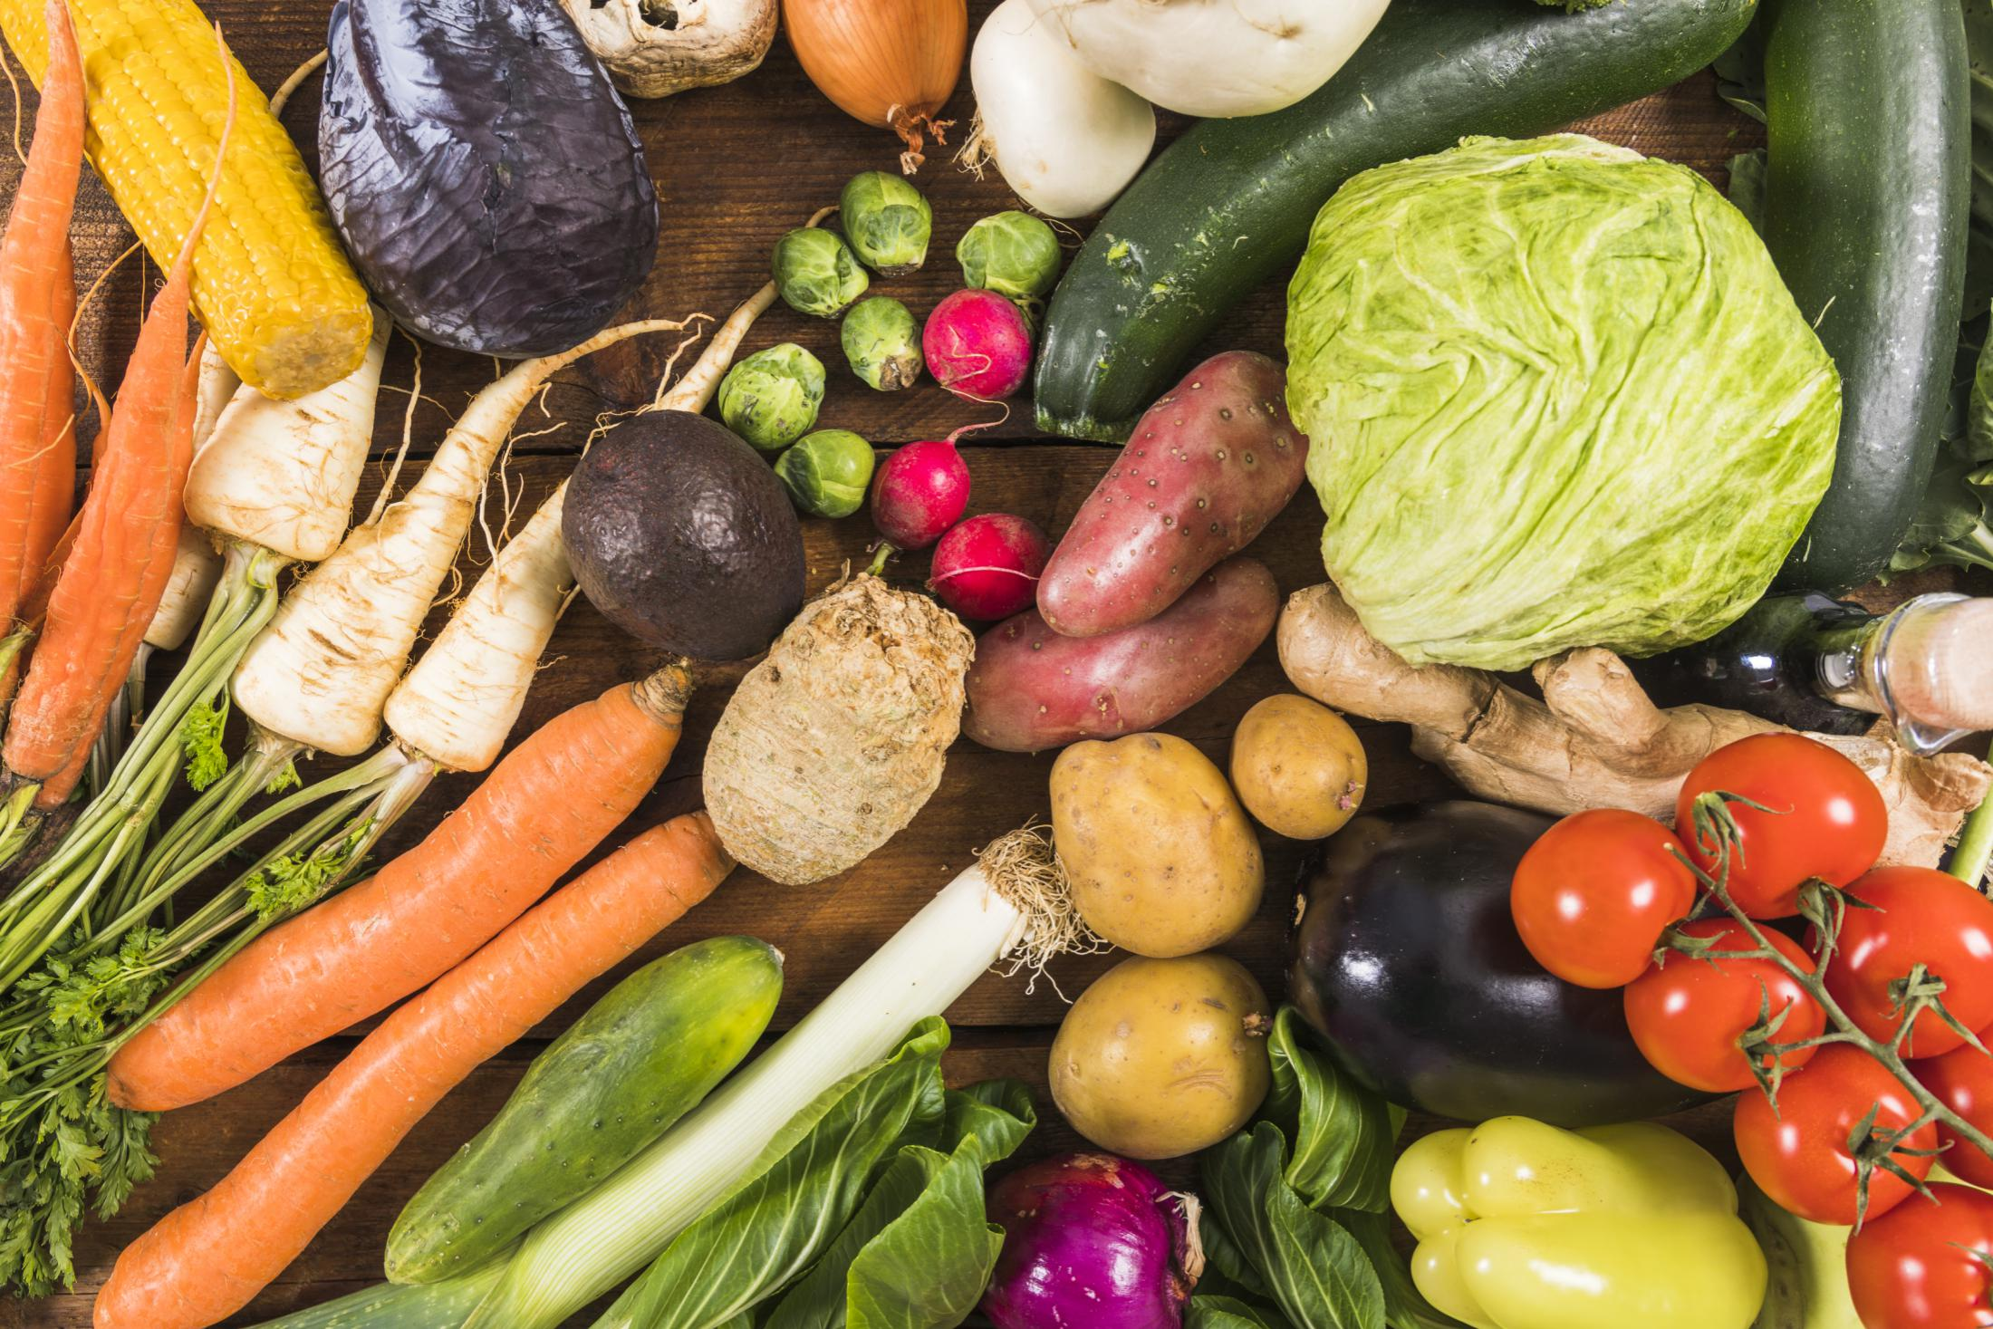
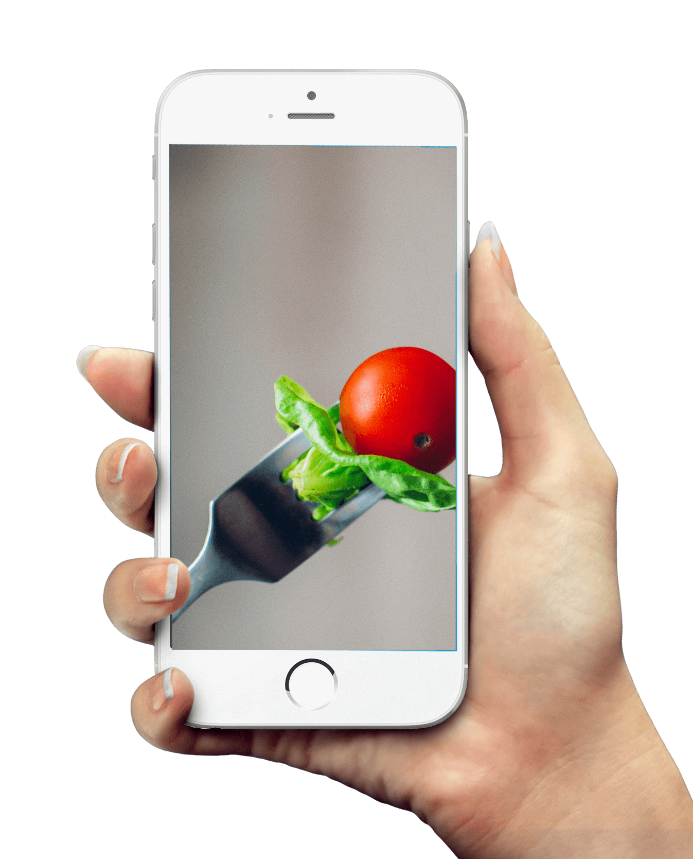
Insights
1. West Europe have highest distinct Flavours (5528)
2. North America have second highest Flavours(4584)
3. Aisa have third highest Flavours(4088)

Slide 4
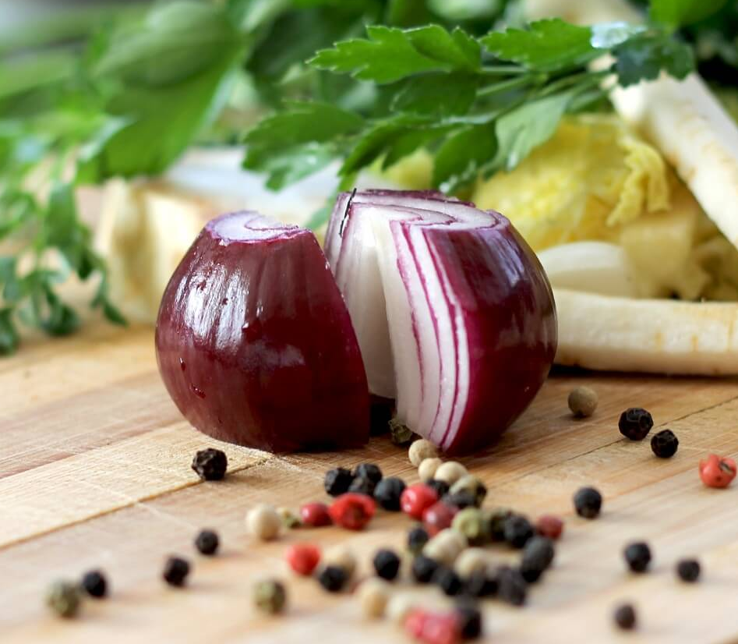
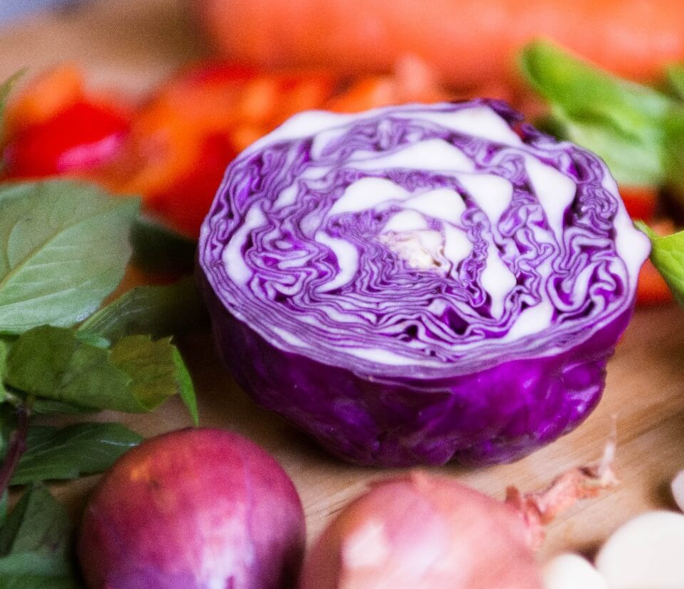
In 2009 highest (17813) products were launched over all regions
In West Europe more products were launched compare to other region in year 2009 (4986) and 2010 (5625).
Most of the Products (49643) were launched in juice & juice drink category over all regions
The highest Products(16487) were launched in juice & juice drink category in West Europe region compared to other regions.

Slide 5
A
1. Orange Flavour was mostly used in Africa .
2. Unflavour was mostly used in Aisa.
B
3. Unflavour was mostly used in East Europe.
4. Orange Flavour was mostly used in Latin America.
C
5. Orange Flavour was mostly used in Middle East.
6. Unflavour was mostly used in North America.
D
7. Unflavour was mostly used in West Europe.
8. Unflavour was mostly used in Australia.

Slide 6
TOP 10 Flavours
This are the top 10 emerging flavours over last five years (2006 to 2010)
1. Aloe vera
2.Aloe vera , Apple ,Red
3.Aloe vera , Cherry
4.Aloe vera , Berry & Bule berry
5.Agave
6.Acacia
7.Aloe vera , Fruits
8.Aloe vera , Berry , Blue berry
9.Aloe vera , Grapes
10.Aloe vera ,Blackcurrant

Slide 7
Aleo vera was one of the most emerging Flavour over last 5 years and in all the regions .
Recommendations
Orange and unflavour product flavours were saled more in all the regions using this 2 flavours can give better growth for all the regions.
The lowest 5 flavours can be removed or chnaged with new flavours which are in demand and likely to users
Aleo vera was one of the most emerging Flavour over last 5 years and in all the regions .
Thus the company can further make decisions by focusing on every region and every flavours in order to get good growth and sales of the company.

Slide 8
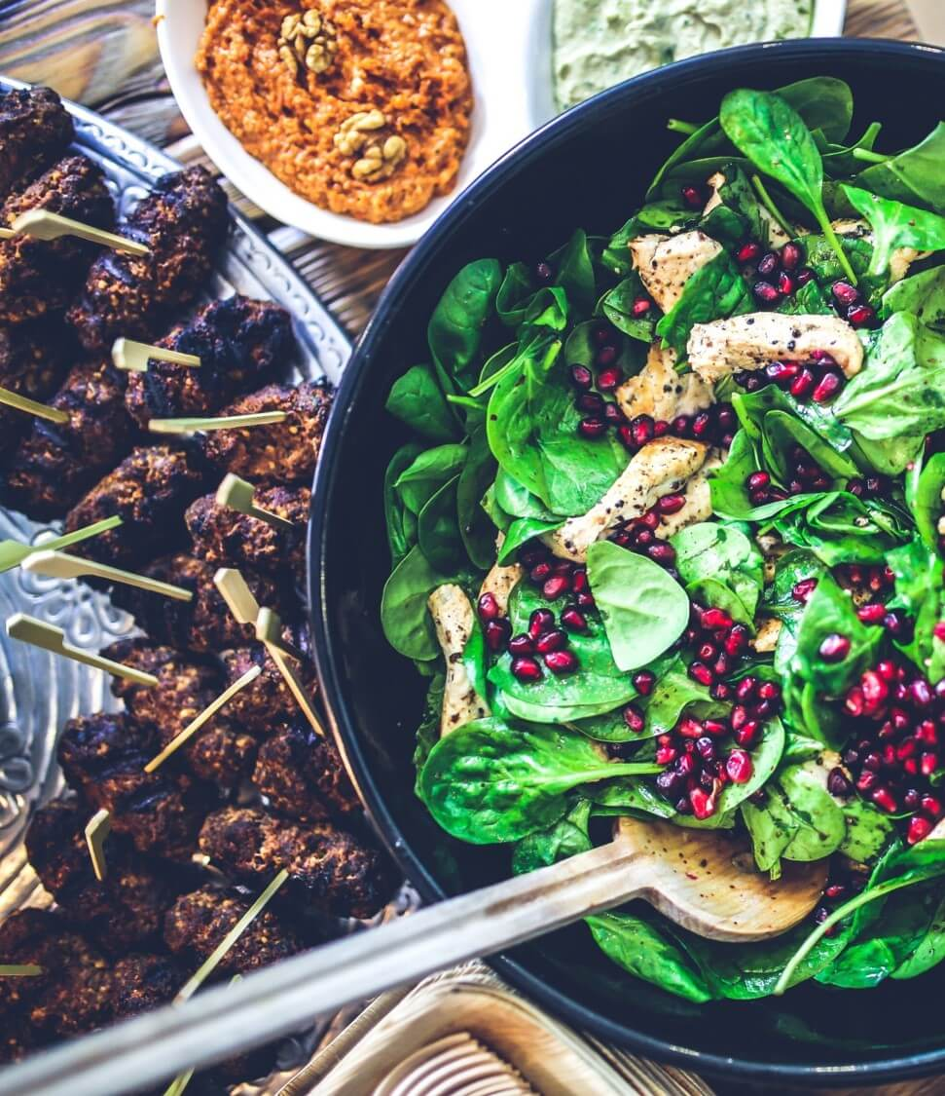
Benefits of using F&B Dashbaord
Having important information at your fingertips.
Supply exact stock to the retails over the regions
Imporve sales & growth of comapny

Slide 9
THANK YOU
Designer：Hajira Kousar

